Slide 1
Determining The Different Profiles of Library Users
GROUP5
JOHN LAURENCE ZABANAL
VIRGILIO MEDINA JR

Slide 2
CONTENT SUMMARY
1) Importing the libraries
2) Loading the data
3) Initial EDA + Initial Pre-processing
4) AutoViz
5) Data Transformation
6) Clustering
7) Understanding the Clusters
8) Conclusion and Recommendations

Slide 3
INTRODUCTION
The surge of COVID-19 in the country has resulted in many challenges in various library services and operations. In effect, the library needs to be proactive to understand the different profile of users to efficiently deliver library services to the community.

Slide 4
DATASET
This project utilizes the datasets generated from the website of San Francisco City which can be retrieved from data.sfgov.org (https://catalog.data.gov/dataset/library-usage).

Slide 5
PROBLEM
1) What are the profiles of San Francisco Library users?

Slide 6
DATA MINING ALGO
1) K-means Clustering
2) Classification (For Cluster Understanding)

Slide 7
BUSINESS VALUE
Findings of this project will provide perspectives and insights that can yield the following benefits:
1) Improved customer satisfaction level 2) Increase users’ library usage 3) Improved visibility of public library within the community

Slide 8
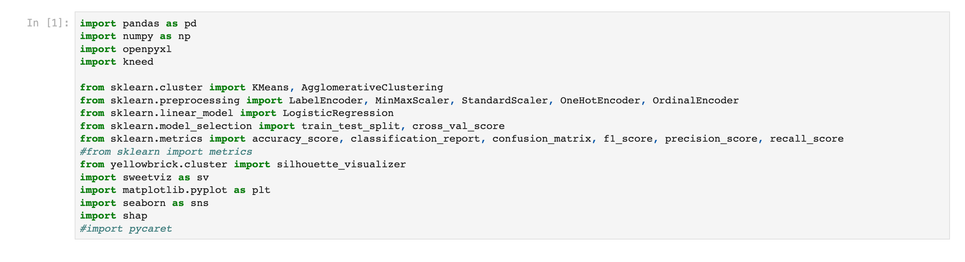
IMPORTING THE LIBRARIES

Slide 9
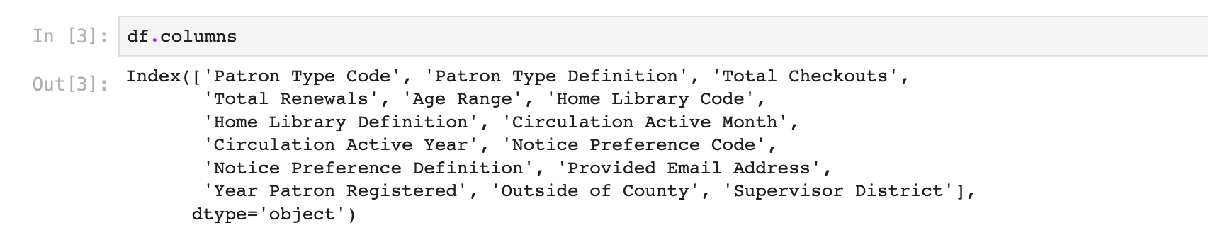
INITIAL EDA + INITIAL DATA PRE-PROCESSING

Slide 10
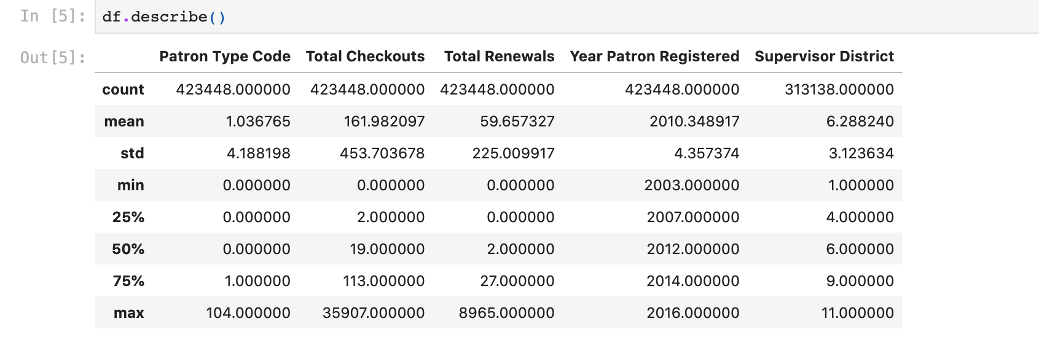
INITIAL EDA + INITIAL DATA PRE-PROCESSING

Slide 11
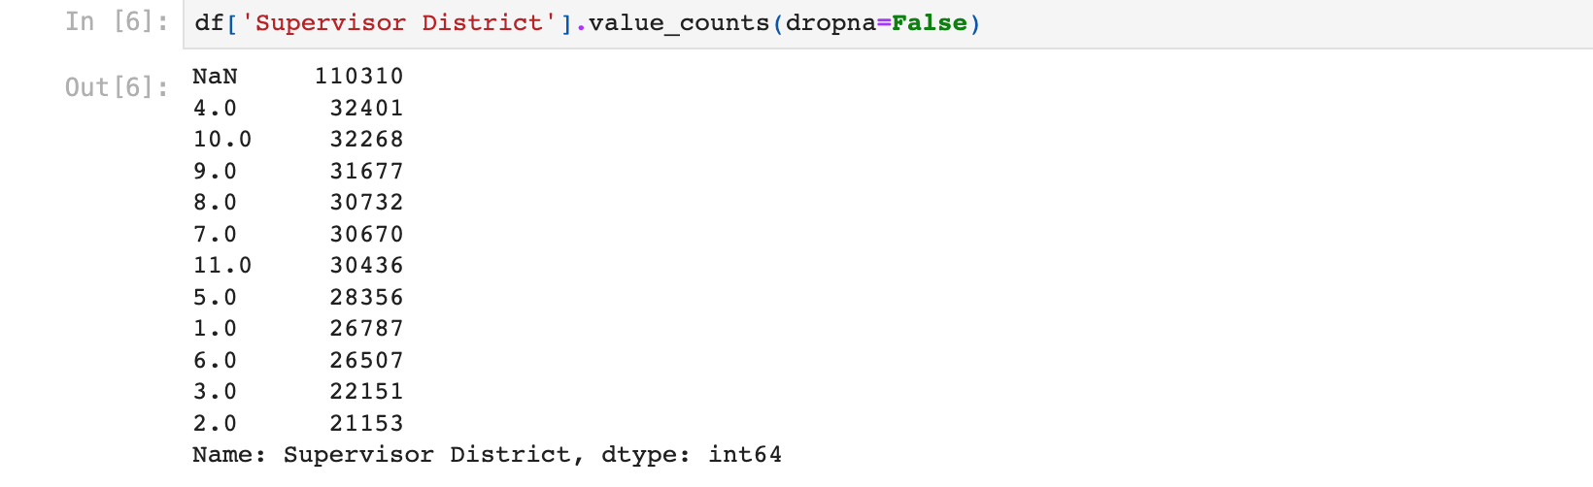
INITIAL EDA + INITIAL DATA PRE-PROCESSING

Slide 12
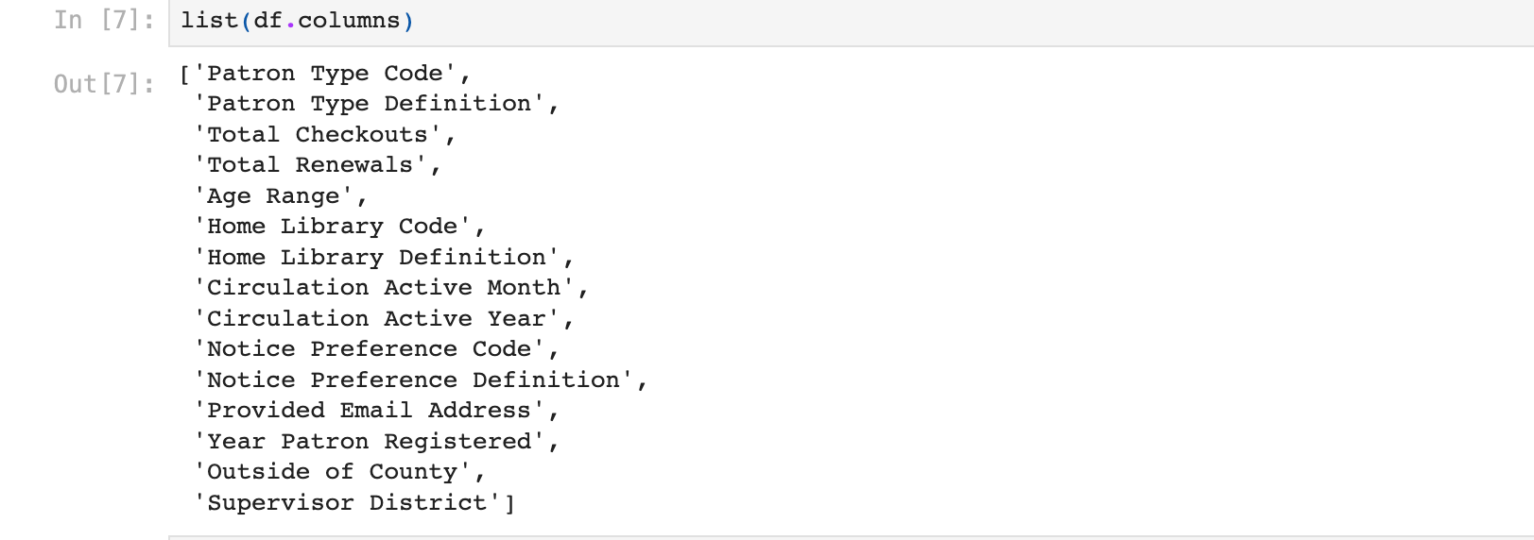
INITIAL EDA + INITIAL DATA PRE-PROCESSING

Slide 13
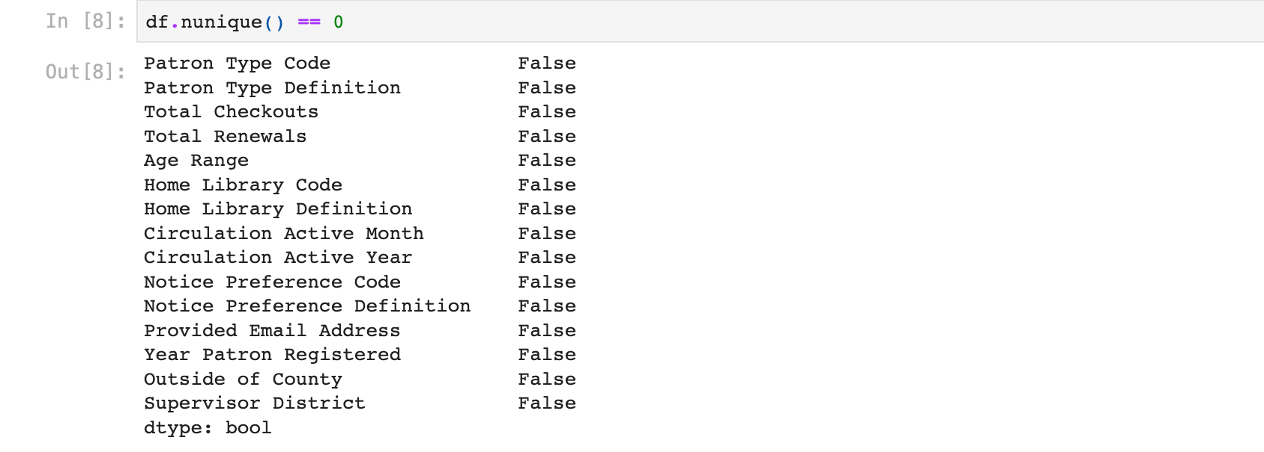
INITIAL EDA + INITIAL DATA PRE-PROCESSING

Slide 14
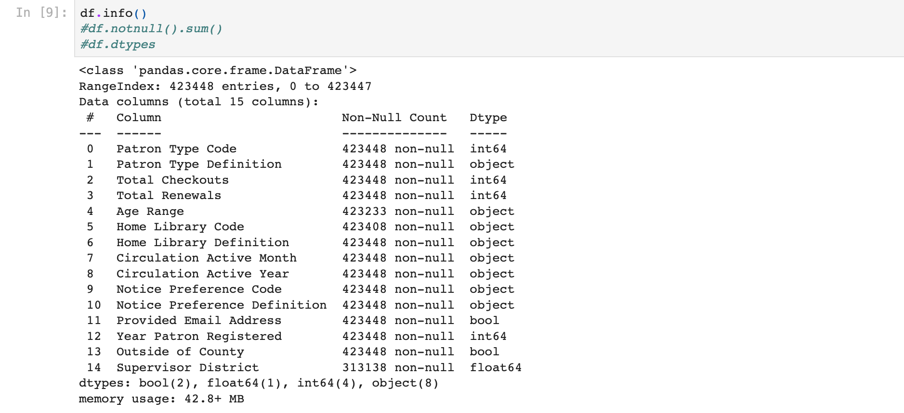
INITIAL EDA + INITIAL DATA PRE-PROCESSING

Slide 15
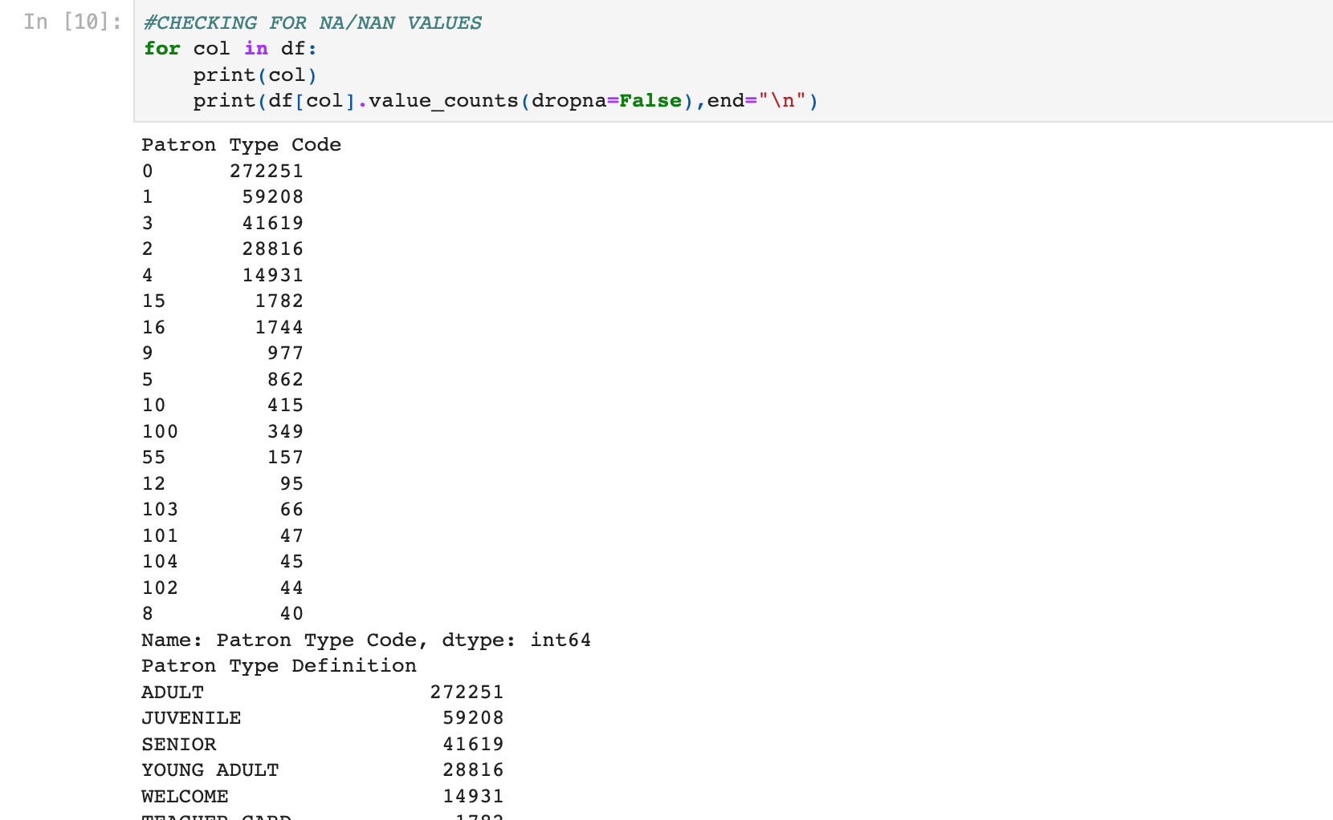
INITIAL EDA + INITIAL DATA PRE-PROCESSING

Slide 16
AUTOVIZ

Slide 17
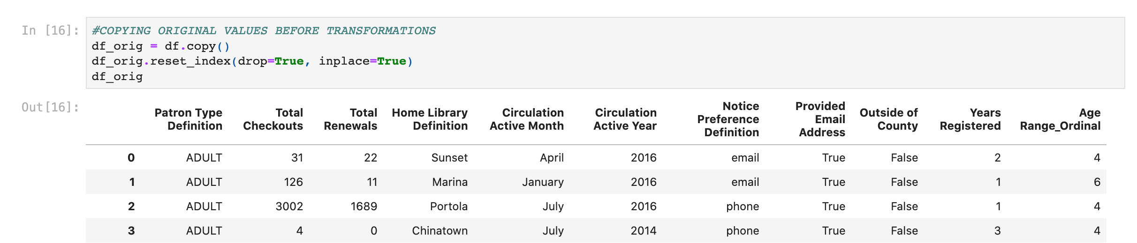
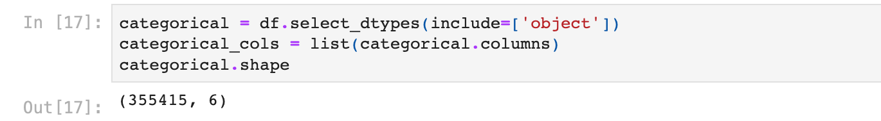
DATA TRANSFORMATION

Slide 18
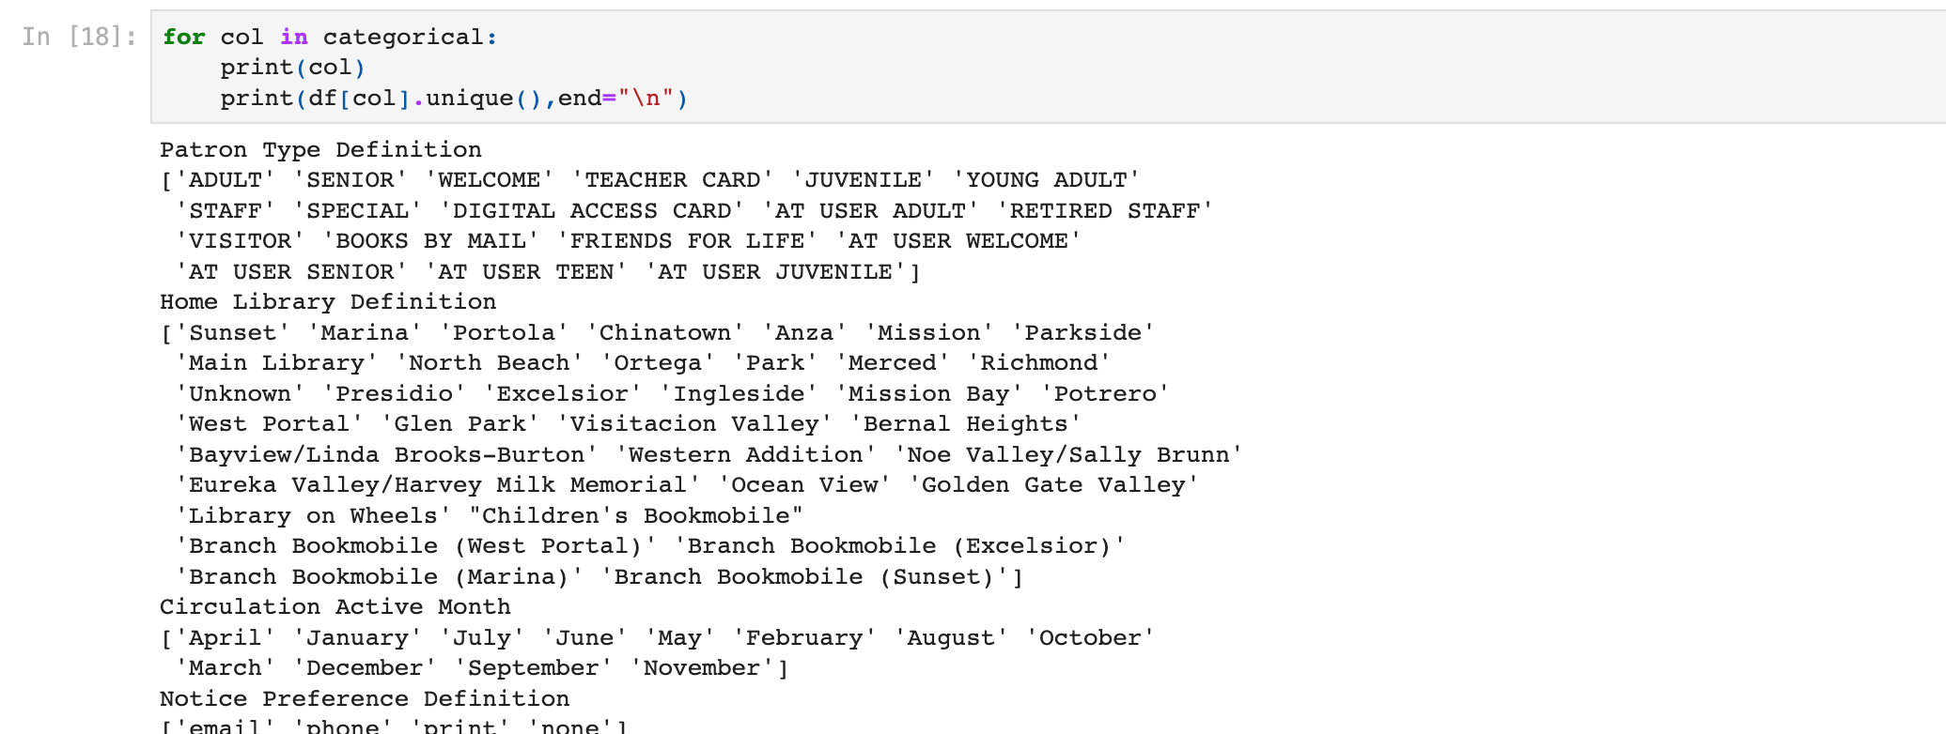
DATA TRANSFORMATION

Slide 19
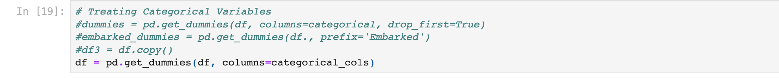
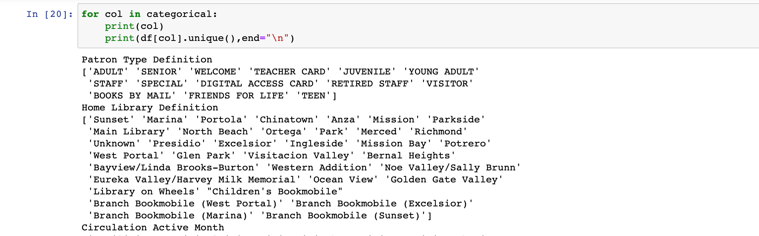
DATA TRANSFORMATION

Slide 20
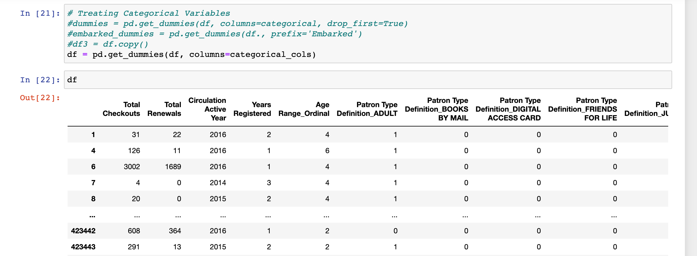
DATA TRANSFORMATION

Slide 21
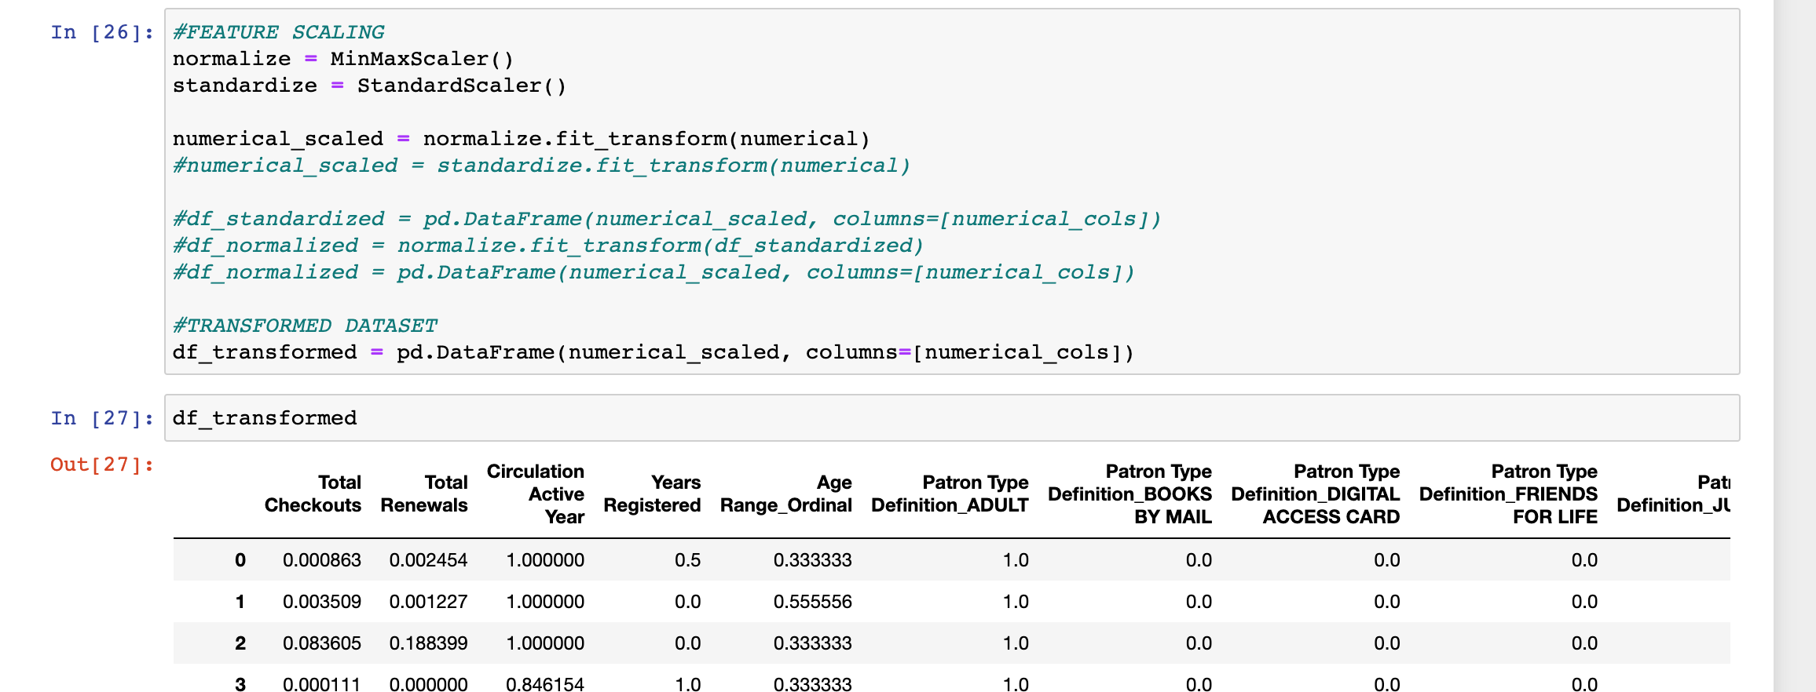
DATA TRANSFORMATION

Slide 22
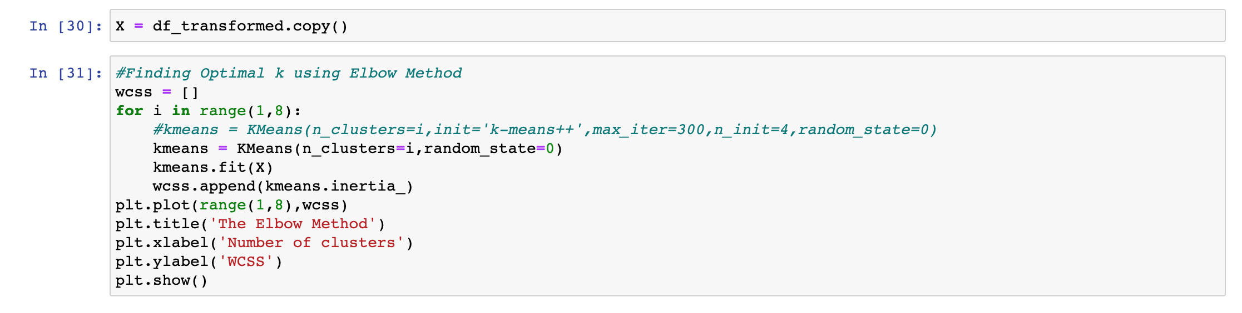
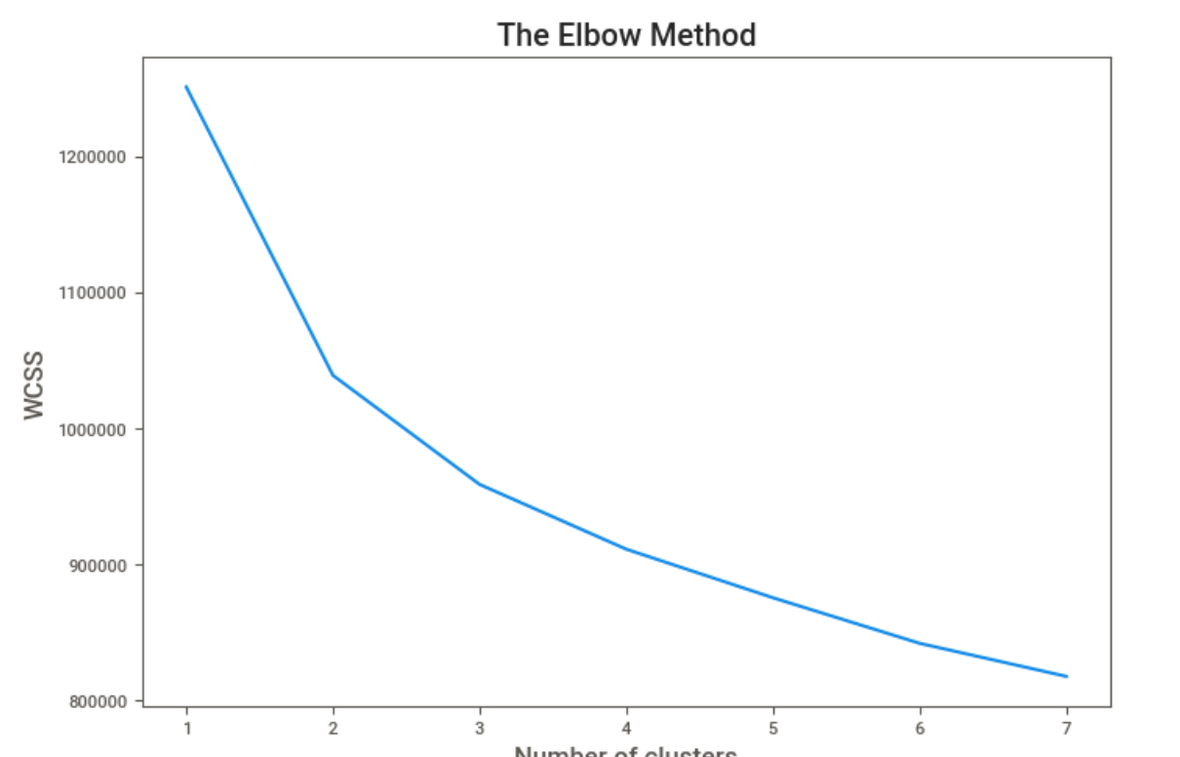
CLUSTERING

Slide 23
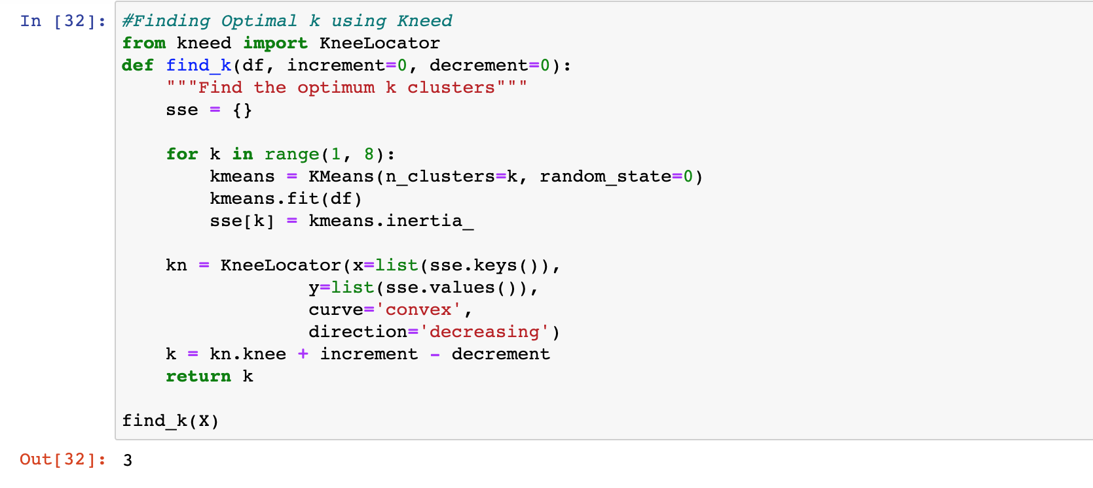
CLUSTERING

Slide 24
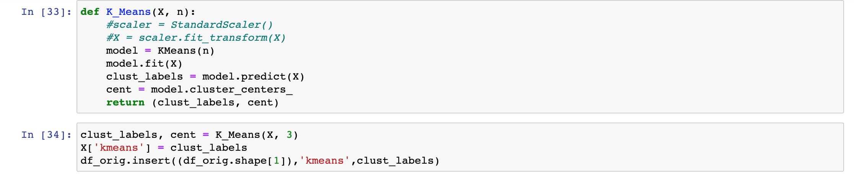
CLUSTERING

Slide 25
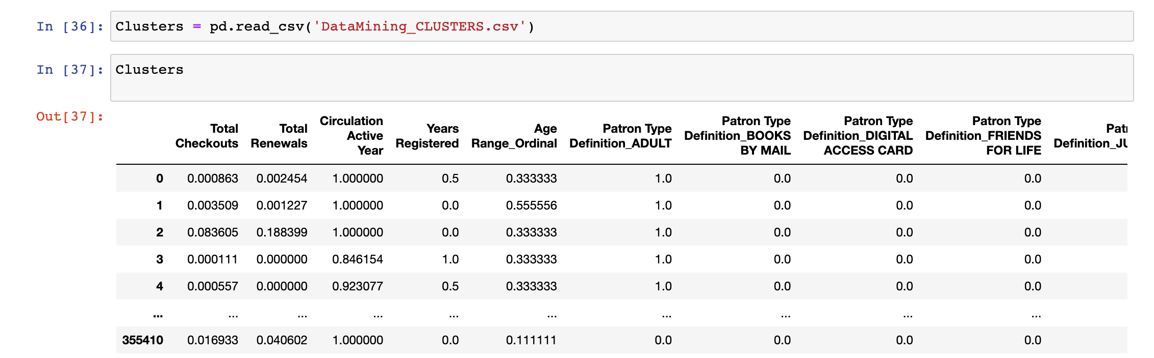
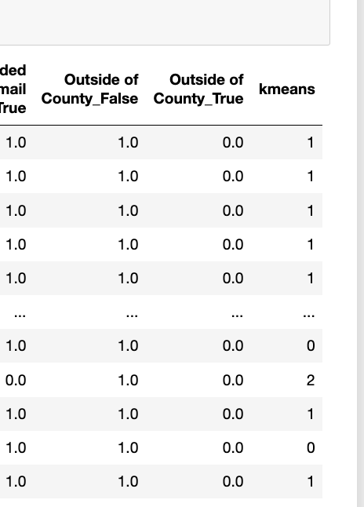
UNDERSTANDING THE CLUSTER

Slide 26
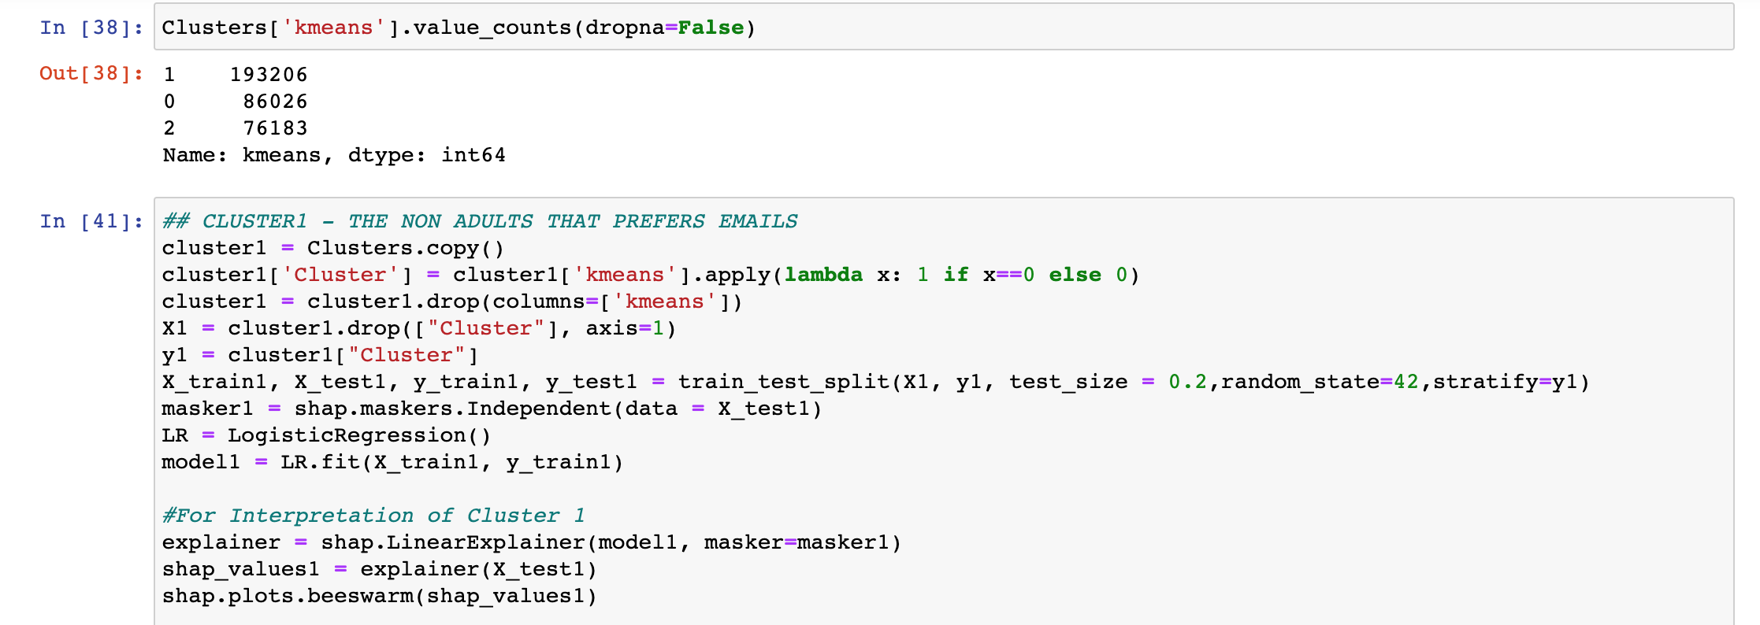
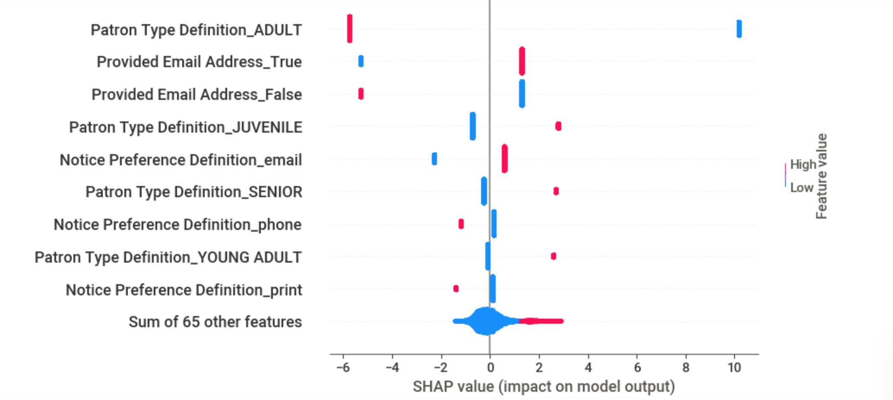
UNDERSTANDING THE CLUSTER

Slide 27
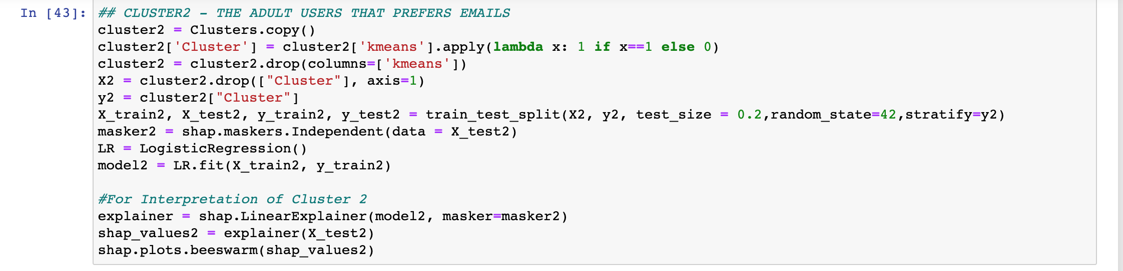
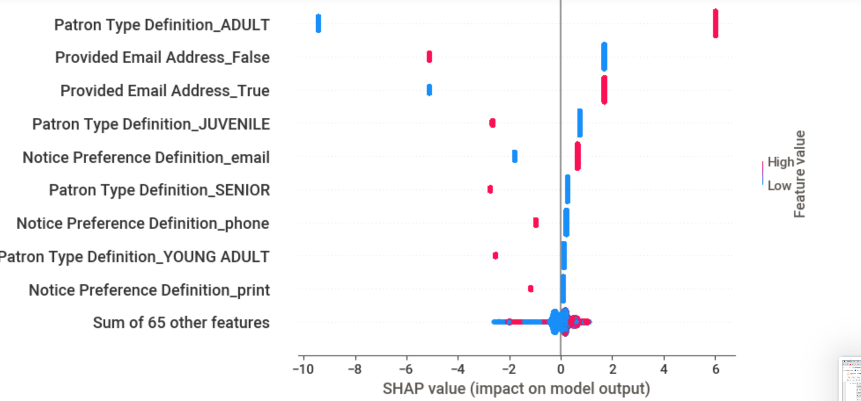
UNDERSTANDING THE CLUSTER

Slide 28
UNDERSTANDING THE CLUSTER

Slide 29
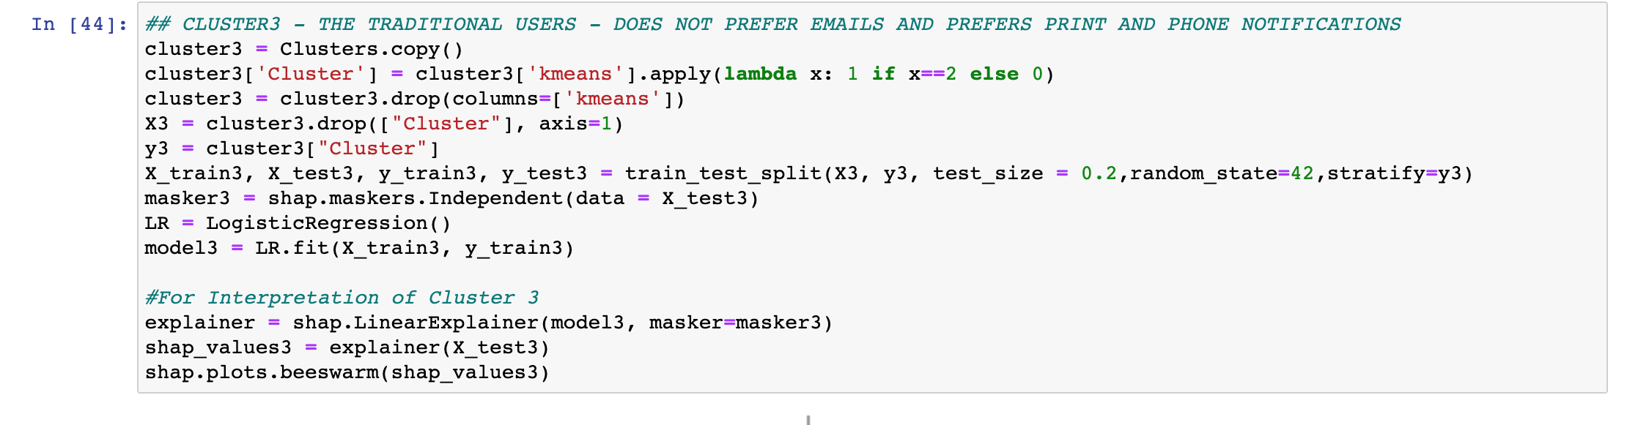
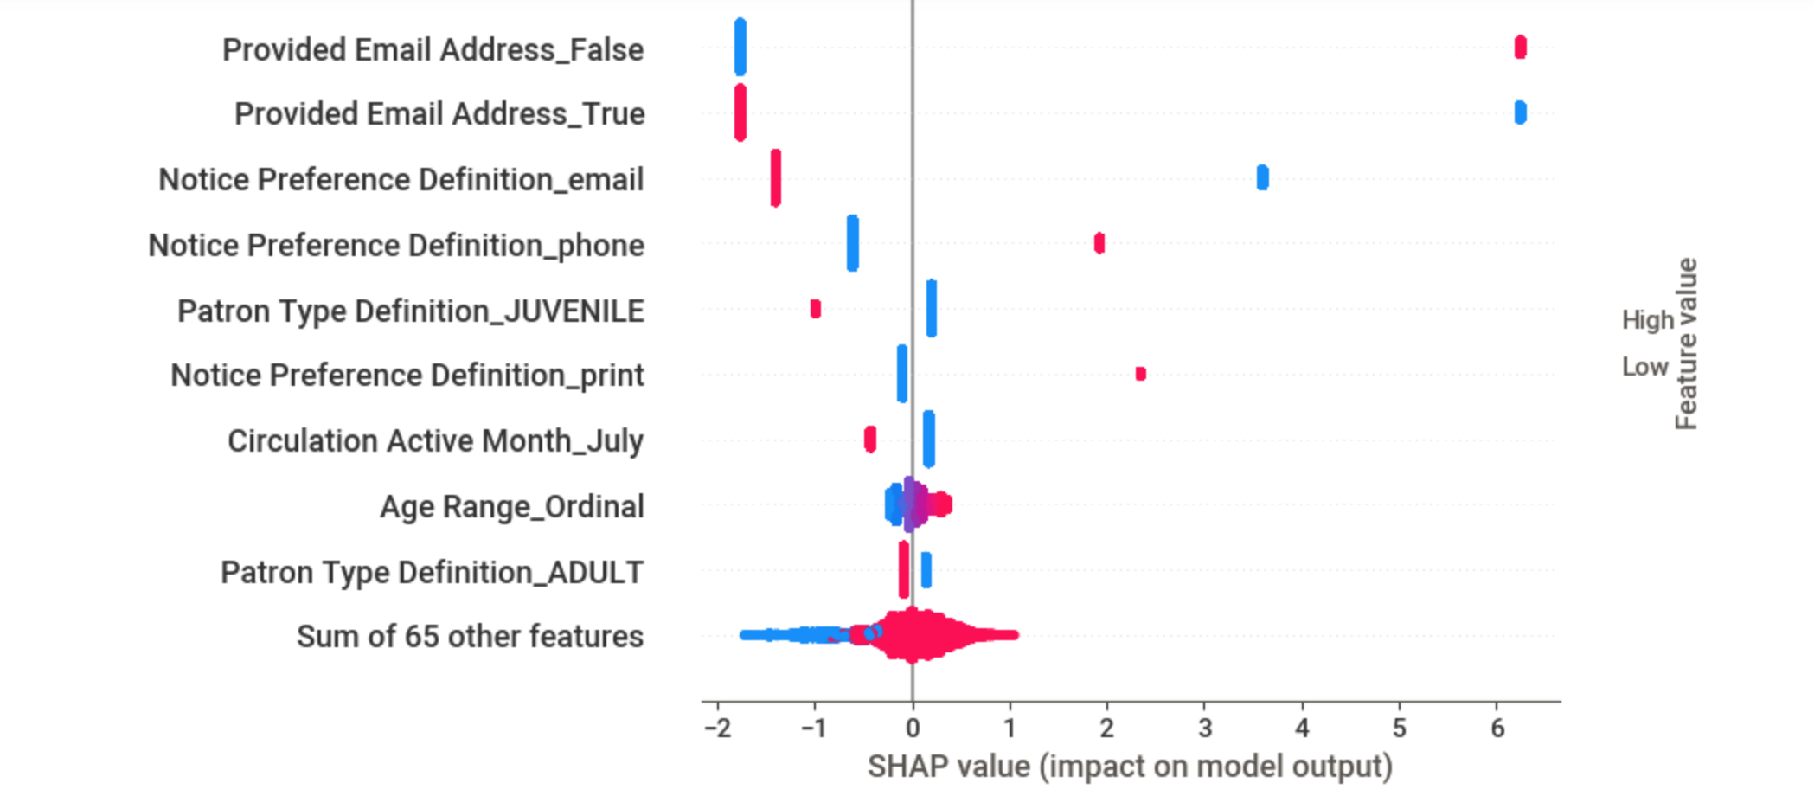
UNDERSTANDING THE CLUSTER

Slide 30
CONCLUSION
1. There are 3 Different Profiles of San Francisco Library Users:
A. Cluster 1 (24.2%) : Non-Adults that prefer Digital Transactions
B. Cluster 2 (54.4%) : Adults that prefer Digital Transactions C. Cluster 3 (21.4%) : Traditional Users that prefer phones and prints
2. Almost 80% of the Users prefer to transact digitally. This insight can then be factored in by the library in their budget allocation.

Slide 31
RECOMMENDATIONS
1. Retain Traditional services: There is still a significant portion of users that prefers to transact traditionally i.e., thru phones and prints. This can be revisited with the latest numbers (especially post-pandemic) before deciding to go fully digital.
2. Focus on Digital services: With the majority of users preferring digital transactions, the library should offer more digital services like webinars and allocate for cloud infrastructures. This also means that there is an opportunity for further Data Science related projects like Recommender systems.

Slide 32

Thank you!

